Slide 1

ALGORITHMIC TRADING
CMR COLLEGE OF ENGINEERING & TECHNOLOGY
Kandlakoya, Medchal, Hyderabad - 501401
Department of Computer Science and Engineering
BATCH NO. 62
L Bharadwaj 18H51A0517
M M Prathyush 18H51A0518
G Vineetkumar 18H51A0596
Under esteemed guidance of
Dr. Sarat Chandra Nayak

Slide 2

CMR COLLEGE OF ENGINEERING & TECHNOLOGY
Kandlakoya, Medchal, Hyderabad - 501401
Department of Computer Science and Engineering
ALGORITHMIC TRADING
BATCH NO. 62
L Bharadwaj 18H51A0517
M M Prathyush 18H51A0518
G Vineetkumar 18H51A0596
Under esteemed guidance of
Dr. Sarat Chandra Nayak

Slide 3
ABSTRACT
Stock market is a probabilistic trading where we can gain and have possibility of loss. Investing in stock market trading might be a risky task.
Algorithmic trading works on the previous trends of a particular stock and help us predicting the stock market movements.
Algorithmic trading use machine learning techniques to increase the probability of profit because it uses the technical analysis of stock, price action strategies, seasonal trends and help us to predict which time is better to invest in stocks.
We are developing an algorithm using machine learning and deep learning techniques such as RNN(Recurrent Neural Network) and LSTM for algorithmic trading.

Slide 4
PROBLEM UNDERSTANDING
MOTIVATION OF STUDY
OBJECTIVES
PROBLEM STATEMENT, SCOPE & LIMITATIONS

Slide 5
MOTIVATION OF STUDY
Stock price prediction is an attractive area where we gain more profits to develop the business.
With a successful model for stock prediction, we can gain insight about market behavior over time.
Machine learning technique will be an efficient method to solve the problem of predicting stock movements

Slide 6

OBJECTIVE
To design efficient system for predicting the stock market movement using ML .
Specifically, use LSTM method to Predict stock price based on the historical data.
Compare existing methods to show the superiority of LSTM.

Slide 7

PROBLEM STATEMENT
Predict stock market movement using machine learning techniques to improve the profit percentage in the trading
P/E * EPS = PRICE
If we can predict stocks future P/E and EPS, We will know accurate PRICE

Slide 8

SCOPE & LIMITATIONS
We predict the stock market up to one month.
It is hard to predict in the pandemic situations

Slide 9
LITERATURE SURVEY

Slide 10
MOVING AVERAGE
Simple moving averages calculate the average of a range of prices by the number of periods within that range.
A simple moving average is a technical indicator that can help in determining if price will continue or if it will reverse a trend.
A simple moving average can be enhanced as an exponential moving average (EMA) that is more heavily weighted on recent price action.

Slide 11
FORMULA:
𝑆𝑀𝐴 = (𝐴1+𝐴2+⋯+𝐴𝑛 ) / n eq(1)
Where:
An= The price of an asset
n = The number of total periods
Example
closing prices over a 15-day period.
Week One (5 days): 20, 22, 24, 25, 23
Week Two (5 days): 26, 28, 26, 29, 27
Week Three (5 days): 28, 30, 27, 29, 28

Slide 12

Statistical
Auto-Regressive Integrated Moving Average
(ARIMA)
ARIMA models are known to be robust and efficient in financial time series forecasting
It constantly outperformed complex structural models in short-term prediction
But they work only for a particular time series data
It is categorized into linear that is it cannot handle nonlinear behavior of stock market

Slide 13
Terminology
Model parameters
AR: Auto Regressive
It is the dependent relationship between
an observation and predefined number of lagged observations
I: Integrated
means the differencing of raw observations
MA: Moving Average
The relationship between the residual error and the observations.
p is the number of lag observations.
d is the degree of differencing.
q is the size/width of the moving average window.

Slide 14

RNN (Recurrent Neural Network)
RNN is a class of advanced artificial neural network (ANN)
It is categorized into nonlinear
RNN takes input from two sources, one is from the present and the other from the past
Information from these two sources are used to decide how they react to the new set of data
But fails in forecasting long term duration

Slide 15

Fig: RNN
In a feed-forward neural network, the information only moves in one direction from the input layer, through the hidden layers, to the output layer.
The information moves straight through the network and never touches a node twice. Feed-forward neural networks have no memory of the input they receive and are bad at predicting what’s coming next.
RNN the information cycles through a loop. When it decide, it considers the current input and what it has learned from the inputs it received previously.

Slide 16
IMPLEMENTATION OF EXISTING MODELS

Slide 17
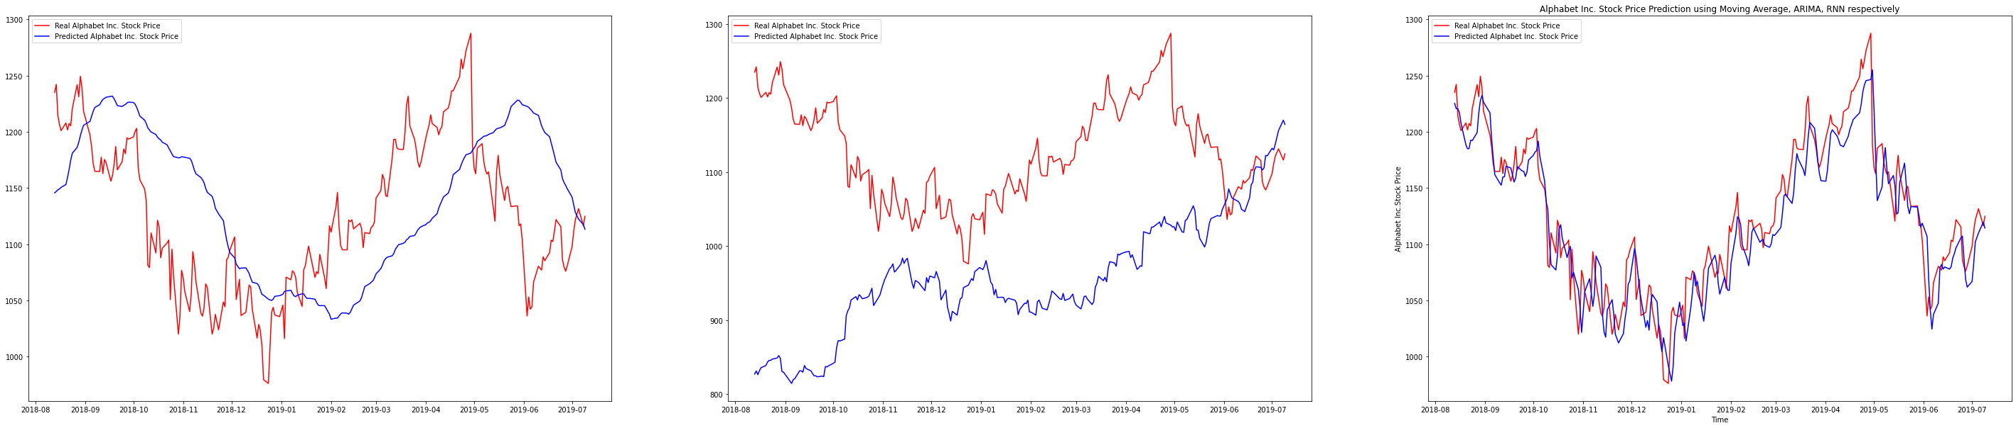
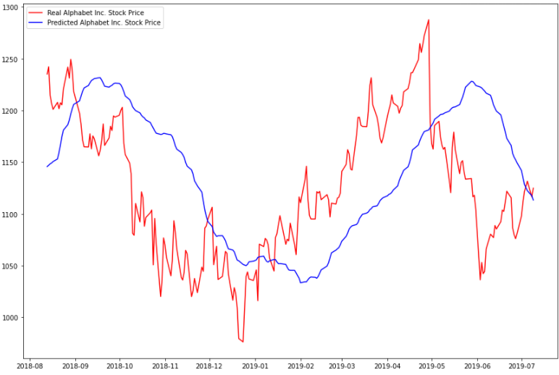
Google stock
SIMPLE MOVING AVERAGE ARIMA RNN
Fig: SMA Prediction

Slide 18
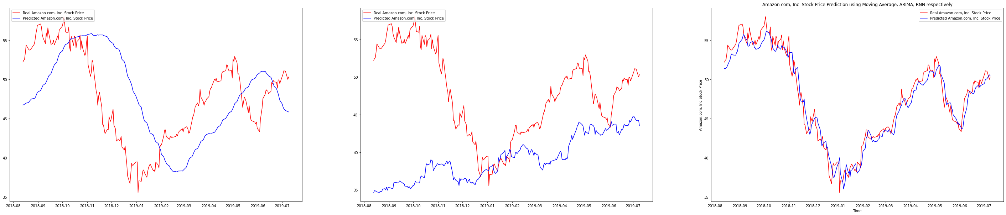
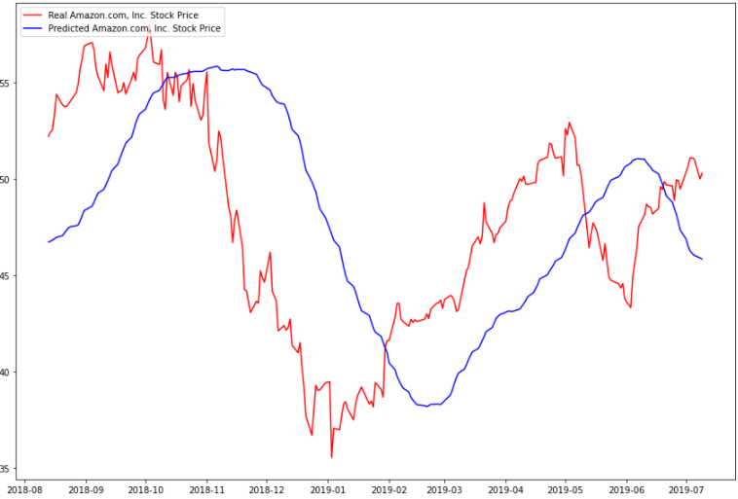
Amazon stock
SIMPLE MOVING AVERAGE ARIMA RNN
Fig: SMA Prediction

Slide 19
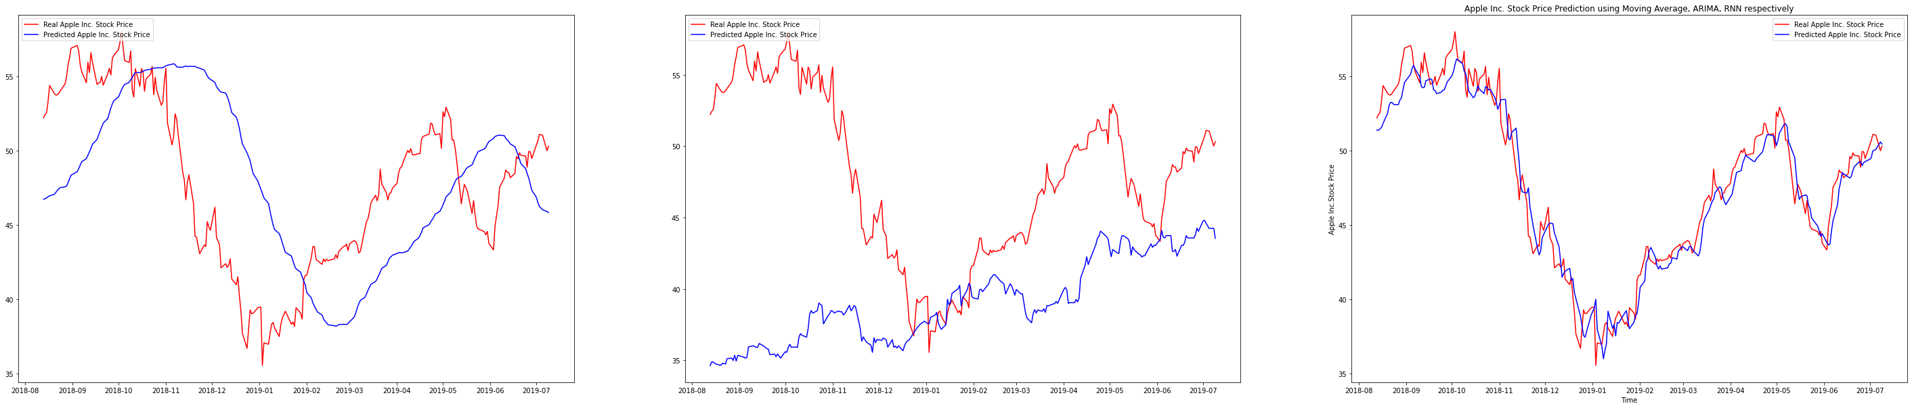
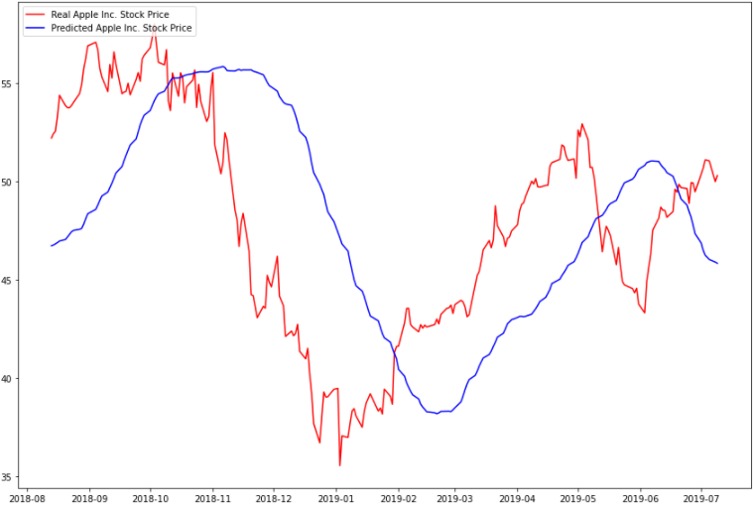
APPLE stock
SIMPLE MOVING AVERAGE ARIMA RNN
Fig: SMA Prediction

Slide 20
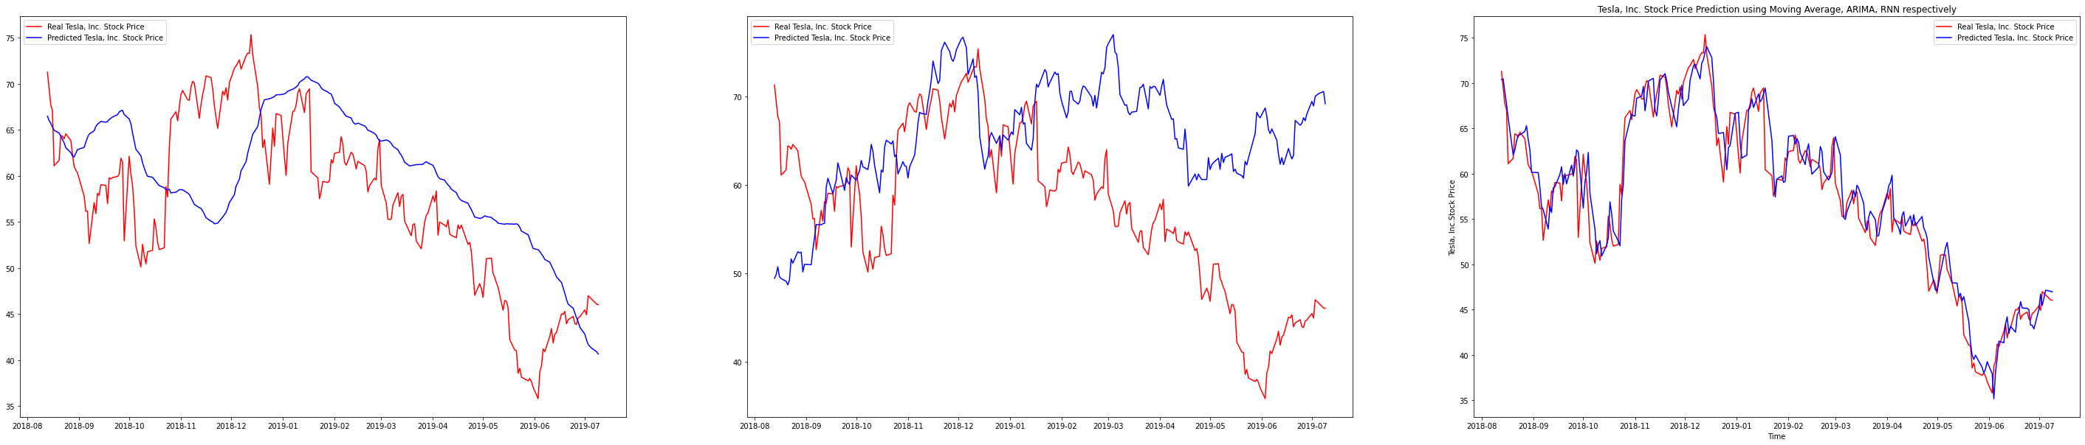
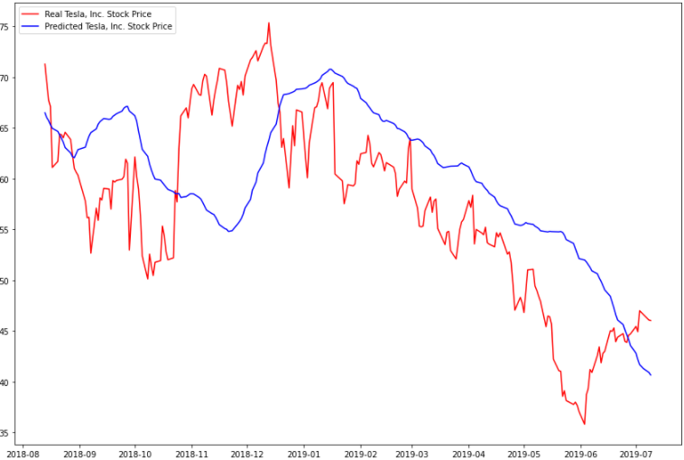
TESLA stock
SIMPLE MOVING AVERAGE ARIMA RNN
Fig: SMA Prediction

Slide 21
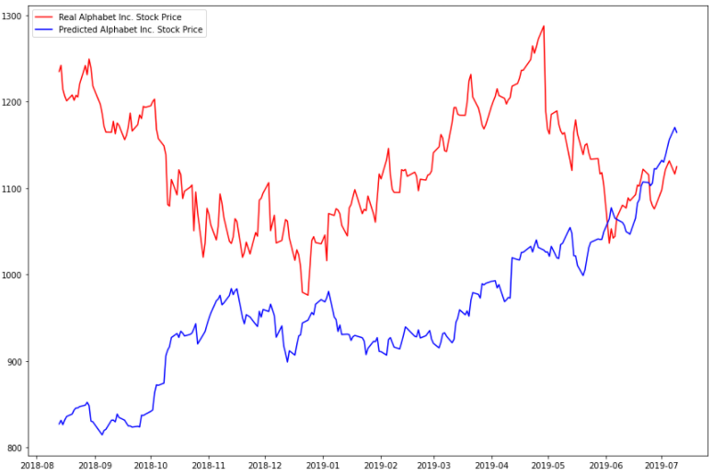
Google stock
SIMPLE MOVING AVERAGE ARIMA RNN
Fig: ARIMA Prediction

Slide 22
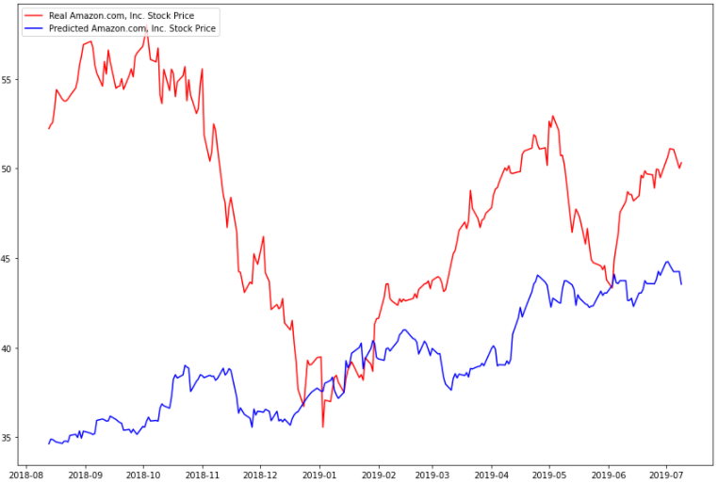
Amazon stock
SIMPLE MOVING AVERAGE ARIMA RNN
Fig: ARIMA Prediction

Slide 23
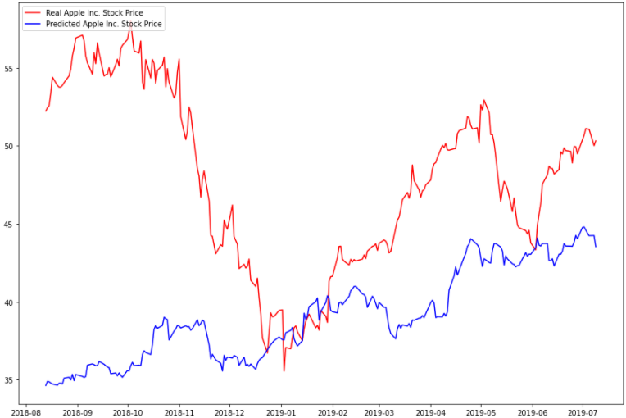
APPLE stock
SIMPLE MOVING AVERAGE ARIMA RNN
Fig: ARIMA Prediction

Slide 24
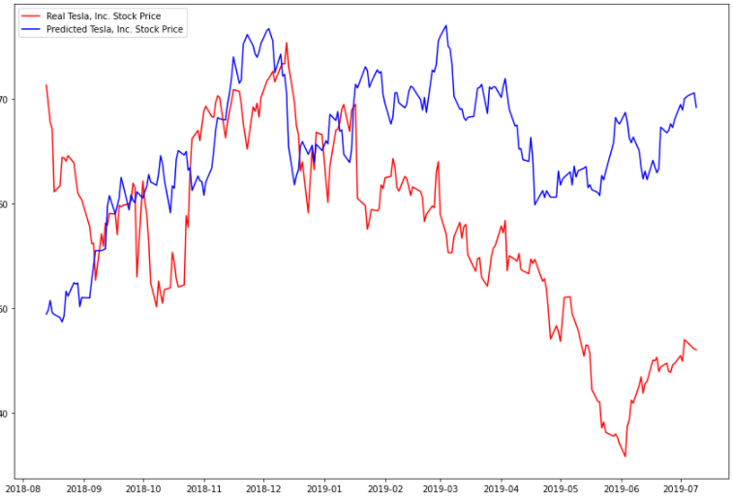
TESLA stock
SIMPLE MOVING AVERAGE ARIMA RNN
Fig: ARIMA Prediction

Slide 25
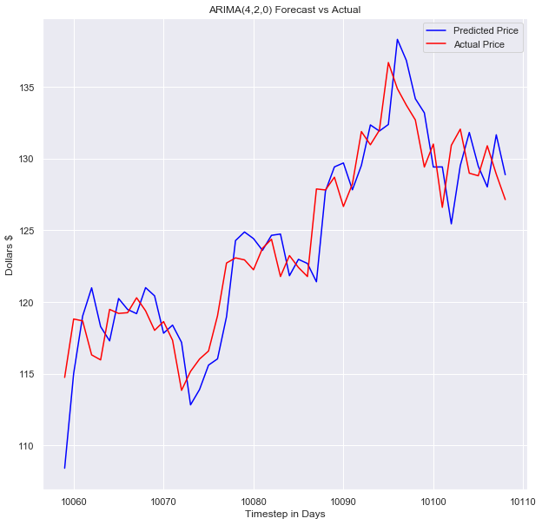
ARIMA 1Day prediction

Slide 26
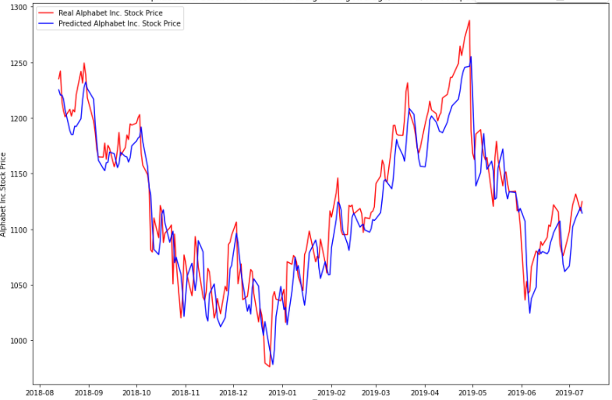
Google stock
SIMPLE MOVING AVERAGE ARIMA RNN
Fig: RNN Prediction

Slide 27
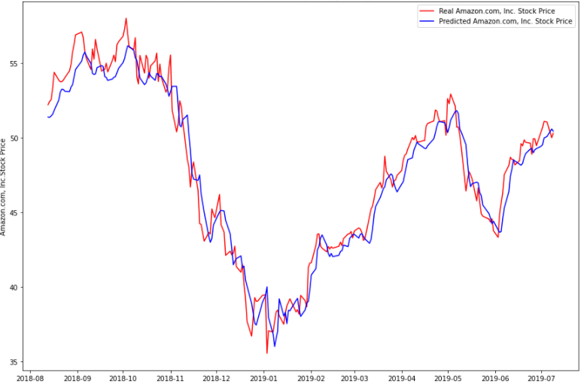
Amazon stock
SIMPLE MOVING AVERAGE ARIMA RNN
Fig: RNN Prediction

Slide 28
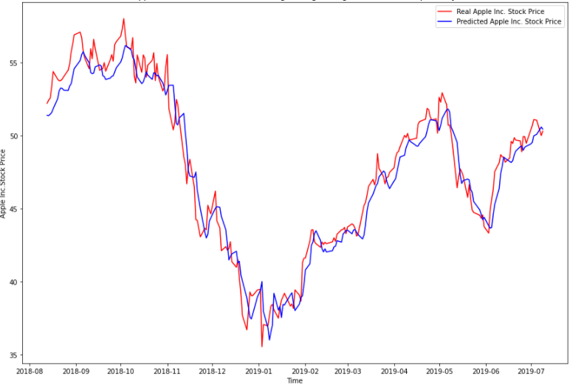
APPLE stock
SIMPLE MOVING AVERAGE ARIMA RNN
Fig: RNN Prediction

Slide 29
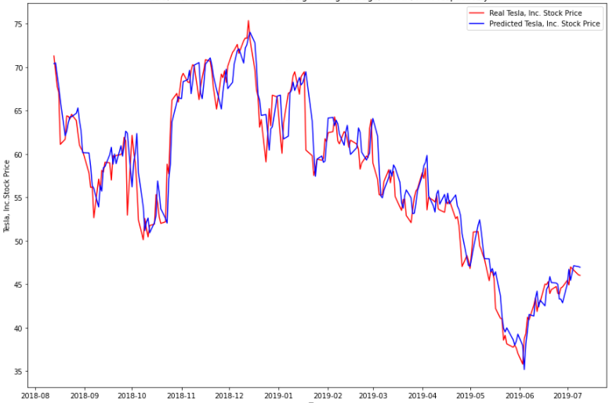
TESLA stock
SIMPLE MOVING AVERAGE ARIMA RNN
Fig: RNN Prediction

Slide 30
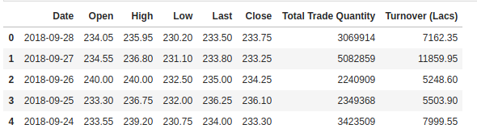
DATA SET COLLECTION
NSE (National Stock Exchange of India)
BSE (Bombay Stock Exchange)
NYSE (New York Stock Exchange)
Money Control
Google Stock Prices
Yahoo
China’s Shanghai and Shenzhen stock markets
Fig: Sample data set

Slide 31
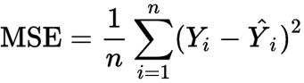
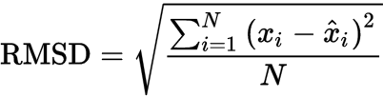
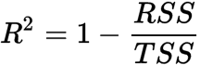
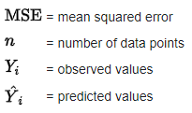
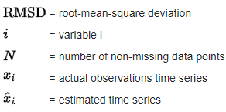
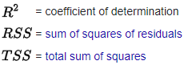
PERFORMANCE METRICS
MODEL | MSE | RMSE | R2_SCORE
Simple Moving average | 5668.585465423127 | 75.2900090677583 | -0.31223237668214043
Arima | 42071.70516132826 | 205.1138833948796 | -8.739264582261903
RNN | 608.6947111664791 | 24.671739119212475 | 0.8590920235074526
Lower (MSE) is the best
Lower (RMSE) is the best
Higher (R2SCORE) is the best

Slide 32
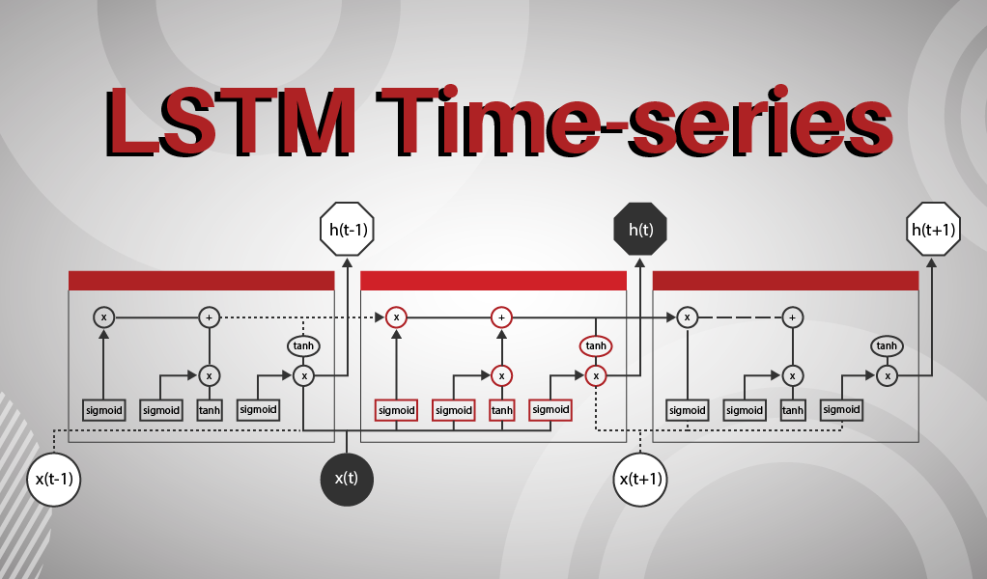

Slide 33
LSTM Long-Short-Term Memory
LSTM is an advanced type of RNN
LSTM is proficient in learning about long-term dependencies.
It solves the vanishing gradient problem
LSTM is popularly used on time-series data for classification, processing, and making predictions.
It doesn’t just use the previous prediction but rather retains data for longer-term
LSTMs are good at processing sequences of data such as text, speech and general time-series.

Slide 34

Vanishing gradient problem
It is encountered when training artificial neural networks with gradient-based learning methods
In such methods, during each iteration of training each of the neural network's weights receives an update
in some cases, the gradient will be vanishingly small, effectively preventing the weight from changing its value.
In the worst case, this may completely stop the neural network from further training.
Fig. problem symbol

Slide 35
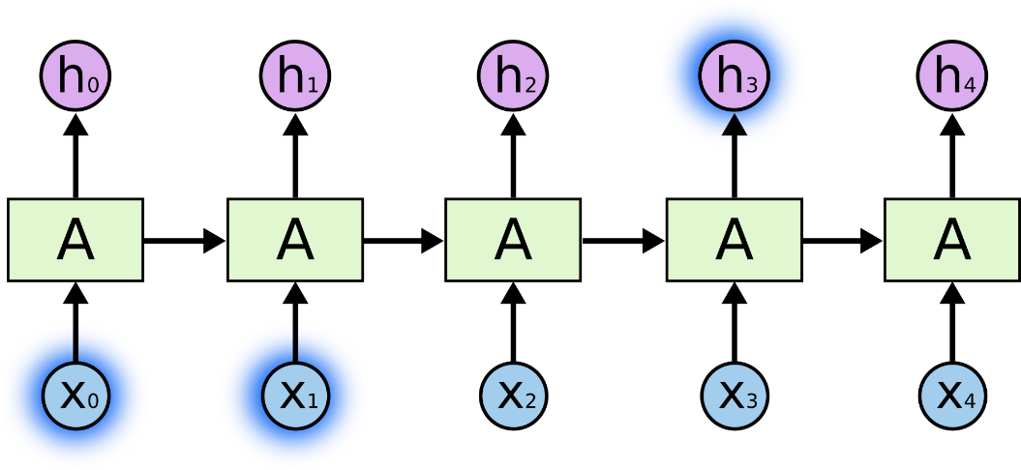
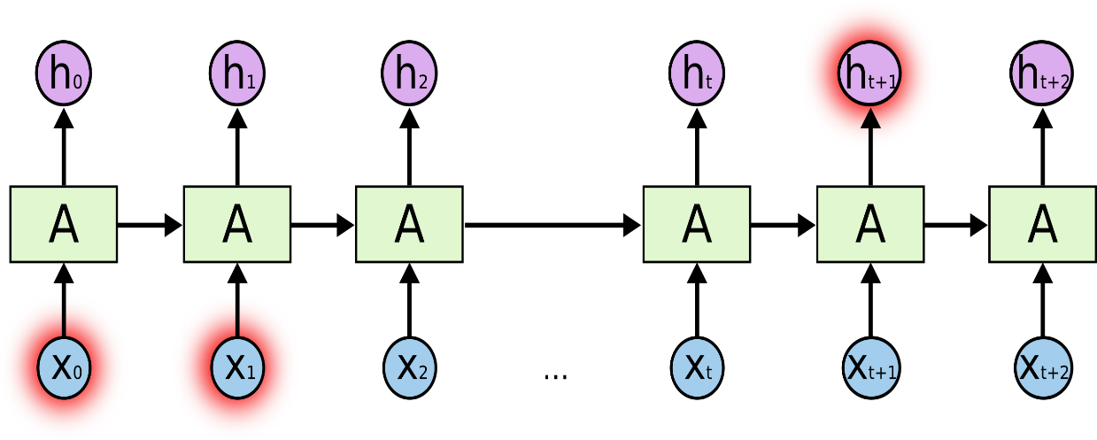
The Problem of Long-Term Dependencies
Fig. RNNs can learn to use the past information.
Fig. Unfortunately, as that gap grows, RNNs become unable to learn to connect the information.

Slide 36
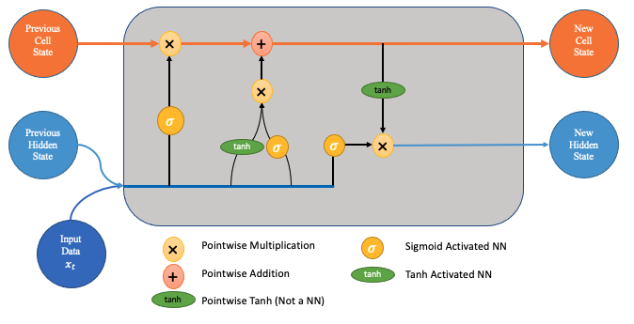
LSTM Long-Short-Term Memory

Slide 37
How do LSTM Networks Work?
The output of an LSTM at a particular point in time is dependent on three things:
▹ The current long-term memory of the network known as the cell state ▹ The output at the previous point in time known as the previous hidden state ▹ The input data at the current time step
LSTMs use a series of ‘gates’ which control how the information in a sequence of data.
There are three gates in a typical LSTM;
forget gate,
input gate and
output gate.

Slide 38
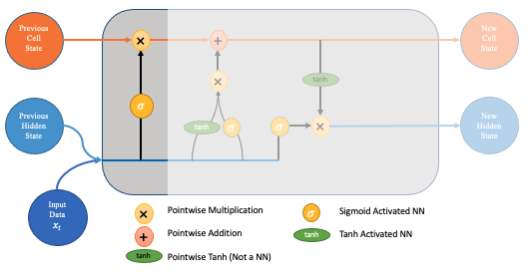
Forget gate decides which pieces should now be forgotten
Fig. Forget gate

Slide 39
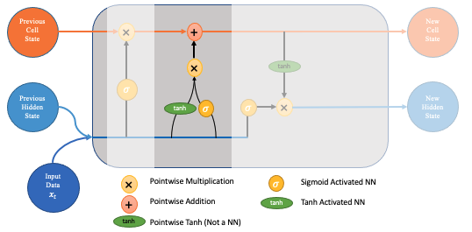
Input gate tells what new information should be added
Fig. Input gate

Slide 40
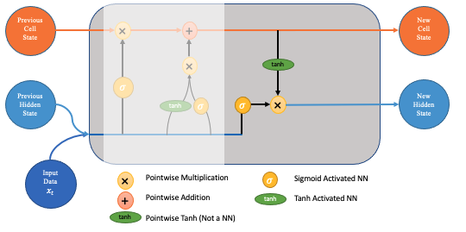
Output gate outputs necessary information
Fig. Output gate

Slide 41
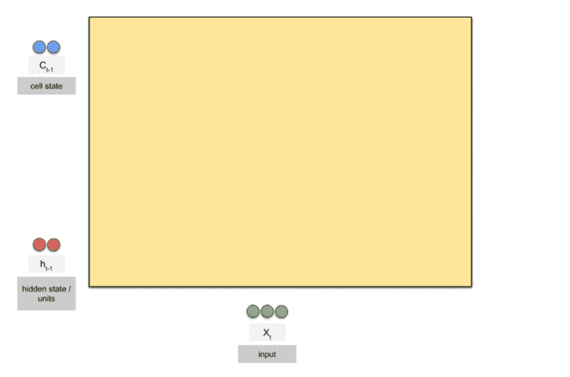
LSTM
Fig. LSTM process

Slide 42
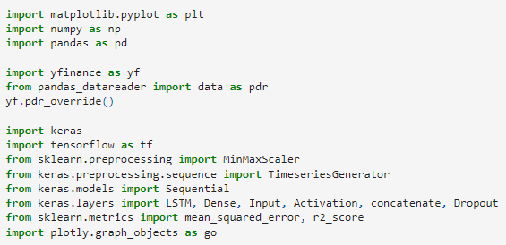
LSTM Implementation – Import Libraries
Fig. import Libraries

Slide 43
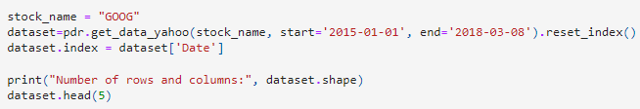
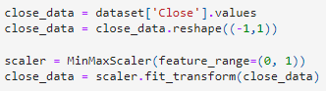
LSTM Implementation – Load Dataset
Fig. Google Stock Data from 2015-2018
Fig. Min Max Scalar for 0 – 1 range

Slide 44
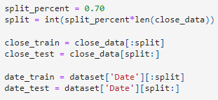
LSTM Implementation – Split Dataset
Fig. Train and Test Data

Slide 45
LSTM Implementation –LSTM Model Parameters
Hidden nodes : This is the number of neurons of the LSTM. If you have a higher number, the network gets more powerful.
Timesteps : the number of timesteps you want to consider.
Learning rate : Indicates, how much the weights are updated per batch.
Batch size : how many samples in each batch during training and testing
Features : how many dimensions are used to represent a data in one time step.
Units : Positive integer, dimensionality of the output space.
Activation : Activation function to use.
Dropout : Fraction of the units to drop for the linear transformation
Return sequences: Boolean. Whether to return the last output. in the output sequence, or the full sequence.

Slide 46
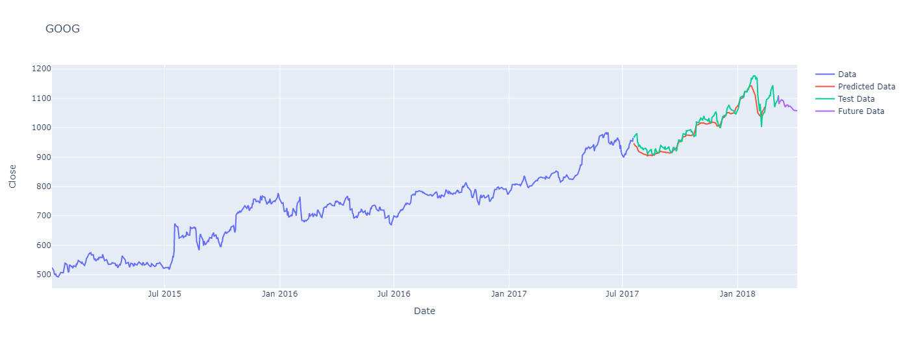
LSTM PREDICTION
Fig. LSTM prediction for Google Stock

Slide 47
PROCESS
start
Identify problem
Literature survey
Objective
Data set
Design
Implementation
Results
Conclusion
end

Slide 48

REFERENCES
https://towardsdatascience.com/time-series-forecasting-predicting-stock-prices-using-an-arima-model-2e3b3080bd70
https://github.com/0xpranjal/Stock-Prediction-using-different-models/blob/main/Notebooks/4.%20RNN_seqtovec_seqtoseq.ipynb
https://github.com/0xpranjal/Stock-Prediction-using-different-models/blob/main/Notebooks/1.%20Time%20Series%20Forecasting%20with%20Naive%2C%20Moving%20Averages%2C%20and%20ARIMA.ipynb

Slide 49
THANK YOU
ALL
OUR GUIDE
TEAM

